Slide 1
Web Survey System
Drop Table team;
Notes:
We are Drop Table Team and, as you guys know by now, our project is the survey system.

Slide 2
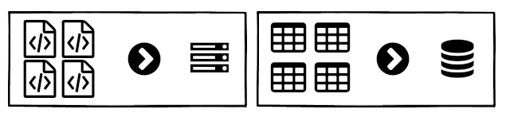
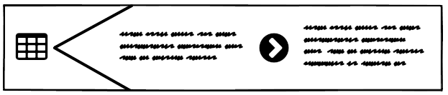
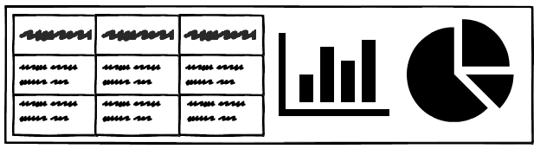
Project Definition
Web-based survey system
Can be implemented on any website
Customizable questions and email script
Generates insightful reports from responses
Notes:
So what are the details of this project? Well, we are looking to build and implement a web-based survey system. It should be easily implementable on any website. The user need only upload the system files, run the create table scripts, and configure the system. Part of the configuration involves customizing the question pool and the automated email script. Then, after a survey is run, the administrator will be able to generate insightful reports from the responses.

Slide 3
What makes it unique?
Semantic Differential Questions (w/ Likert Scale)
Survey Structure Targets Companies of Any Size
Left Statement (Positive) |  |  |  | Right Statement (Negative)
 | Strongly Agree | Mostly Agree | Partly Agree | Partly Agree | Mostly Agree | Strongly Agree
CSC 490 is great! | • | ◦ | ◦ | ◦ | ◦ | ◦ | CSC 490 is awful!
 | 1 ➡ ∞ |  | 1 ➡ ∞ |  | 1 ➡ ∞
Company |  | Survey |  | Department |  | Participant
Notes:
So what sets this system apart from existing solutions? First of all, it uses semantic differential questions, whereby the survey participant is presented with two opposing statements. The user then indicates which statement they agree with and the degree to which they agree with it. In this way, the questions feature a mix of semantic differential scale and likert scale. Then there’s the survey structure, which targets companies of any size or function. After the administrator creates a company entry in the system, they can run multiple surveys on that company. For each survey, there are one or more departments, and for each department, there are one or more participants.

Slide 4
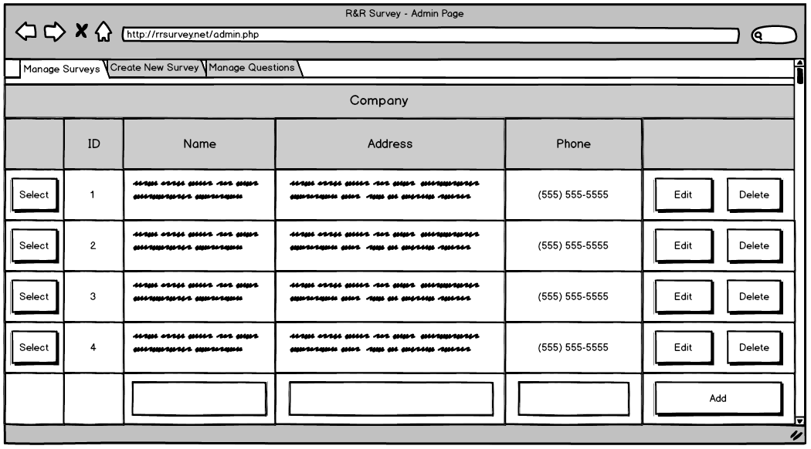
Mockup Walkthrough

Slide 5
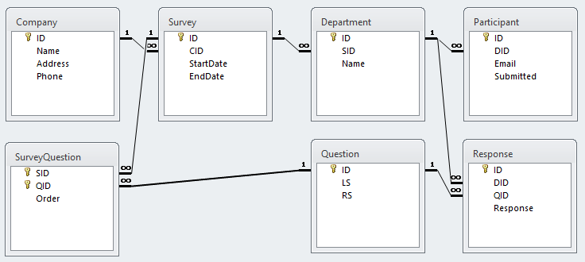
ER Diagram

Slide 6
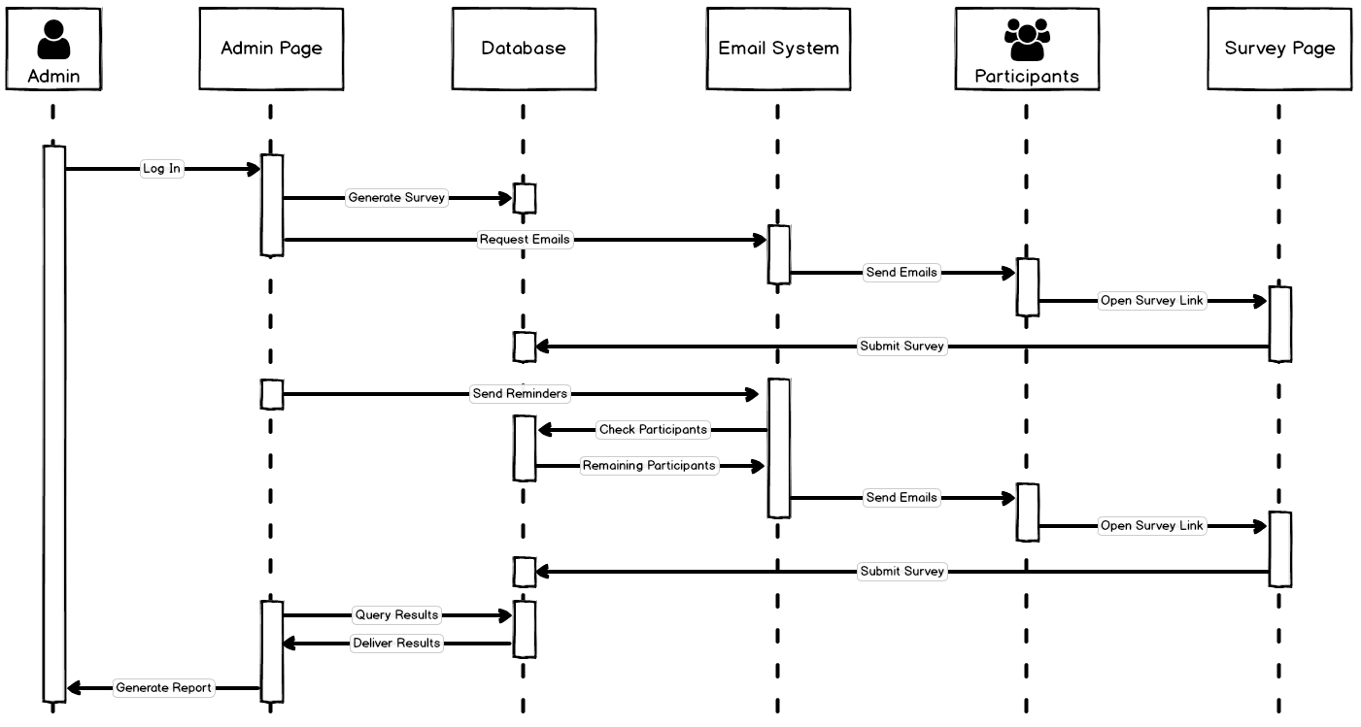
System Model

Slide 7
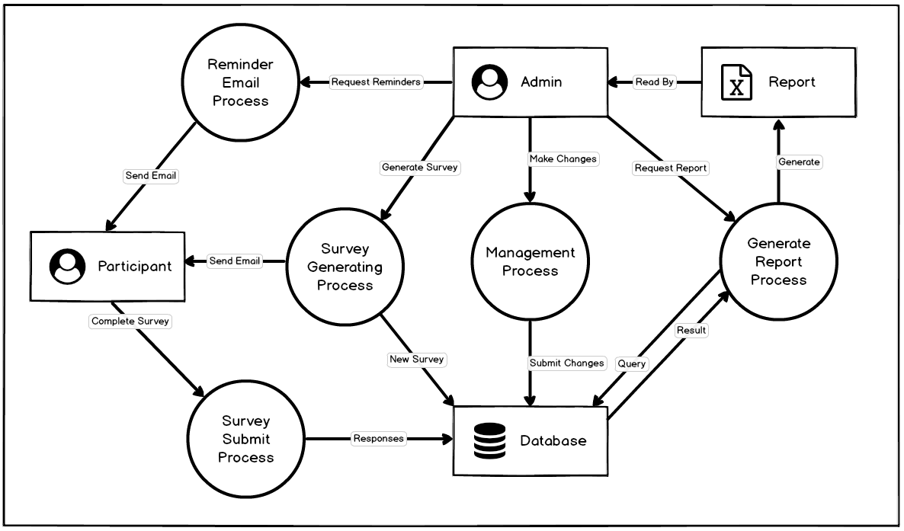
System Model

